Slide 1
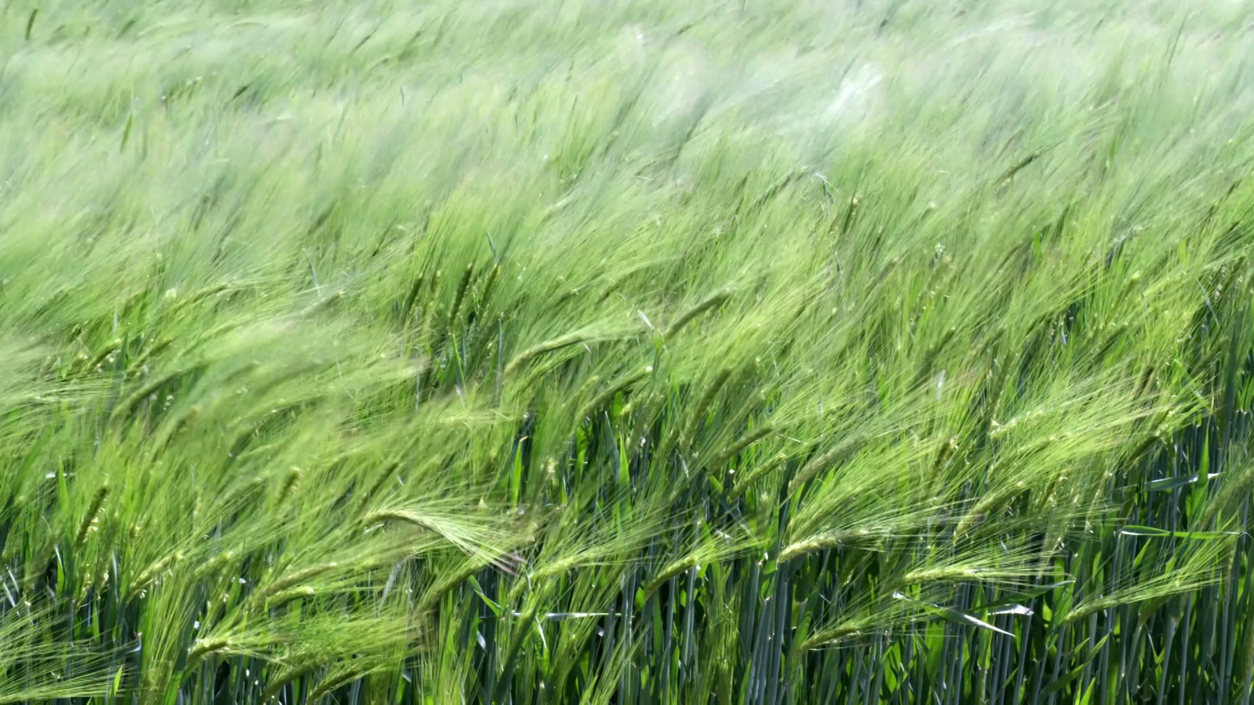
Agricultural Pests Image Classification
Presented by
Y. Krishna Guptha - 160120737155
P. Manoj Kumar - 160120737157

Slide 2
Contents
Abstract
Literature survey
Motivation
Problem Statement
Existing Methodology
Model Comparison
Proposed Model
Proposed Model Architecture
Accuracy and Loss History

Slide 3
Abstract
The project "Agricultural Pests Image Classification" aims to develop a deep learning model to classify 12 different types of agricultural pests based on images. The project uses sequential model to leverage the customized Inception-V3 model.
The project also utilizes data augmentation techniques to improve the model's generalization capability. The model is implemented using TensorFlow and Keras libraries and trained on a dataset consisting of 5494 images of pests where 4395 images are used while training and 1099 while testing. The evaluation metric used to assess the model's performance include accuracy, loss, validation accuracy and validation loss.
The project demonstrates the effectiveness of deep learning in solving real-world problems, such as pest classification, and provides a useful tool for farmers and agricultural researchers to identify and control pest infestations in their crops.

Slide 4
Existing Literature
Proposed By | Dataset | Methodology Used
A. Alghamdi et al | Saudi Arabian Agricultural Pests Dataset (SAAPD) | In the study by A. Alghamdi et al, the authors used the VGG16 architecture pre-trained on ImageNet and fine-tuned it on the Saudi Arabian Agricultural Pests Dataset (SAAPD). They achieved an accuracy of 87.44% after training the model for 50 epochs.
S. Kumar et al | Agricultural Pest Dataset (APD) from India | S. Kumar et al used the Inception V3 architecture on the Agricultural Pest Dataset (APD) from India. They applied various preprocessing techniques and transfer learning and achieved an accuracy of 85.2%.
T. M. Ahmed et al | Bangladeshi Agricultural Pests Dataset (BAPD) | T. M. Ahmed et al used pretrained CNN models (ResNet50, VGG16, InceptionV3) and transfer learning on the Bangladeshi Agricultural Pests Dataset (BAPD). They achieved an accuracy of 86.22%.

Slide 5
Existing Literature
Proposed By | Dataset | Methodology Used
A. Mishra et al | Indian Agriculture Pest Dataset (IAPD) from Punjab | In the study by A. Mishra et al, the authors used the VGG16 architecture on the Indian Agriculture Pest Dataset (IAPD) from Punjab. They also used an ensemble of models and achieved an accuracy of 85.81% after training the model for 100 epochs.
Aditya Singh et al. | A publicly available dataset of tomato leaf images | In their study, Aditya Singh et al. proposed a deep learning-based approach for tomato leaf disease detection using the VGG16 architecture. They used a publicly available dataset of tomato leaf images. The model achieved an accuracy of 85.9% after training for 100 epochs.

Slide 6
Motivation
The motivation behind the Agricultural Pests Classification project is to help farmers and researchers identify and classify pests affecting their crops.
Pests are a major threat to food security and can cause significant damage to crops, resulting in significant economic losses. Traditional methods of pest identification and classification are often time-consuming, expensive, and require specialized knowledge.
The project aims to provide a more efficient and accurate solution by leveraging the power of deep learning and computer vision.

Slide 7

Problem Statement
The project aims to classify agricultural pests using a deep learning model. It can significantly improve pest identification and management, which is critical for effective pest control strategies. The model will provide an automated solution to identify and monitor pests accurately and efficiently. Ultimately, it will help farmers and agricultural experts to identify pests and take necessary action to prevent crop damage.

Slide 8

Existing Methodology
Data Collection(KAGGLE – AGRICULTURE PEST DATASET)
Image Pre-processing(Scaling the pixel values and augmentation)
Model Selection
Training(Compiling and fitting the model)
Model Evaluation(Accuracy, loss at each epoch)
Result(Test Accuracy data visualization)
Model Optimization(Tuning)

Slide 9
Model Comparison
Name | Accuracy | Description
Customized VGG16 | 64.33 | The model was trained to classify agricultural pests with a dataset of 12 classes and evaluated using ImageDataGenerator for data augmentation and ReduceLROnPlateau for learning rate scheduling. The training process resulted in a model with an accuracy of around 64% on the test set.
Customized VGG19 | 71.79 | This model loads and augments image data, creates a model by adding a dense layer to a VGG19 model, compiles the model. The model is then trained and evaluated with regularization with an accuracy of 71%.
Customized Inception-V3 | 87.62 | This code trains a custom image classification Inception-V3 model as a base. The model is trained for 25 epochs with regularization. The accuracy and loss metrics are tracked during training using the validation set.

Slide 10
Proposed Model-(Inception-V3)
Inception-V3 is a deep convolutional neural network architecture that was developed by Google researchers in 2015. It is a powerful image recognition model that has achieved high accuracy on various computer vision tasks, including object detection and image classification.
In this project, Inception-V3 was chosen as the customized pre-trained model because it has been shown to achieve high accuracy on a variety of pest image classification tasks and has been extensively used and studied in the deep learning community.
Additionally, its architecture includes advanced features such as inception modules and global average pooling, which can help capture more complex features and reduce overfitting.

Slide 11
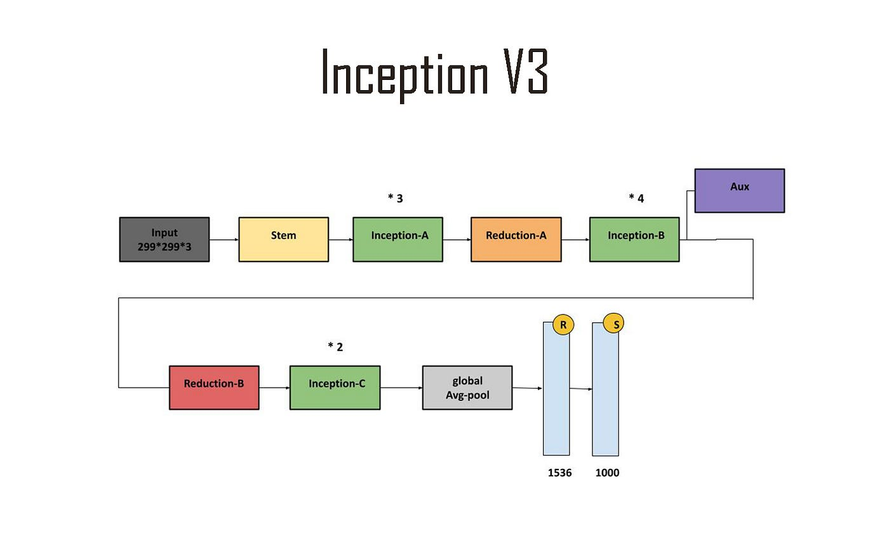
Proposed Model Architecture
1024
12

Slide 12
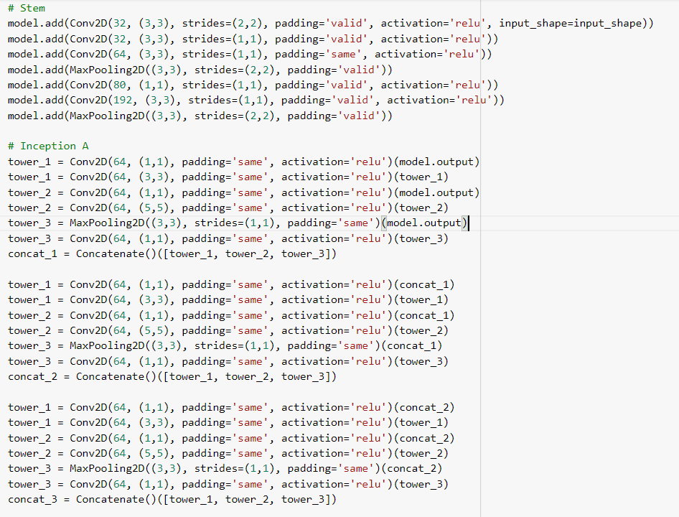
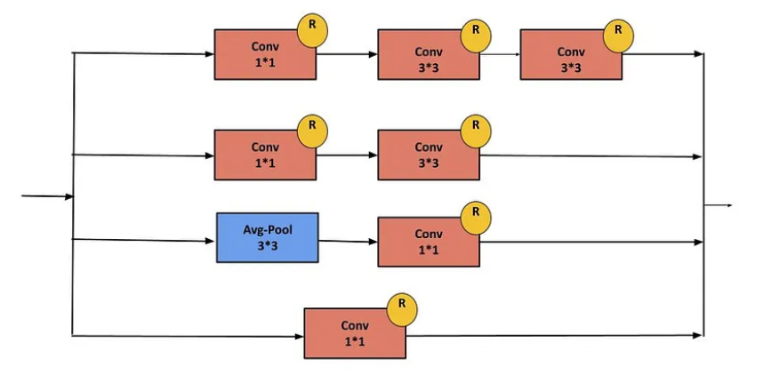
Inception-A Block

Slide 13
Proposed Model Architecture
1024
12

Slide 14
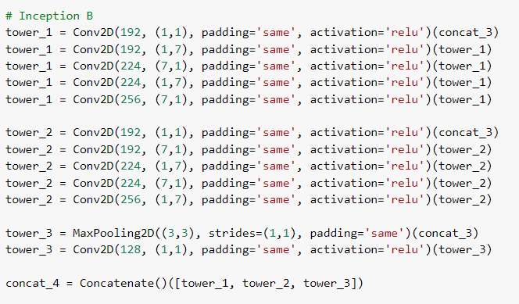
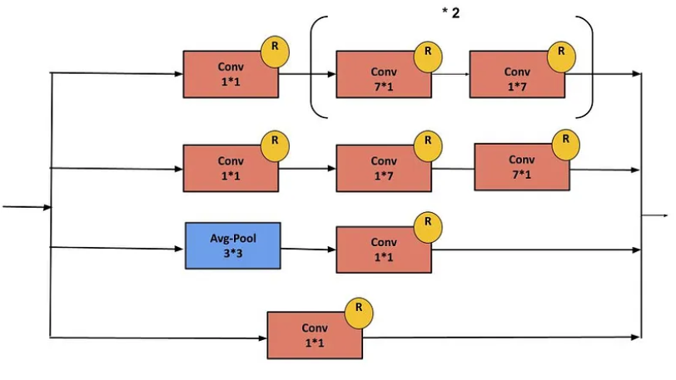
Inception-B Block

Slide 15
Proposed Model Architecture
1024
12

Slide 16
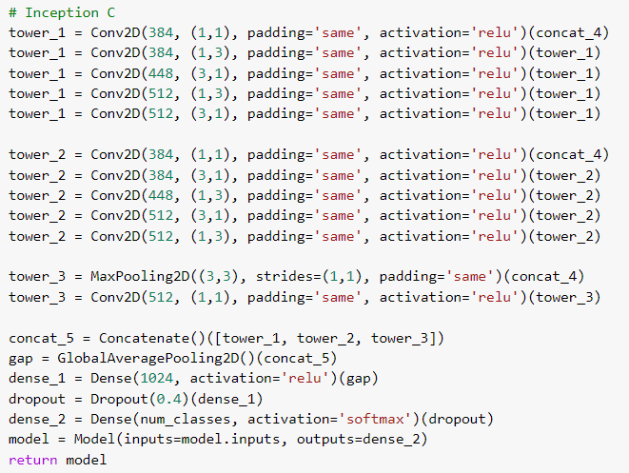
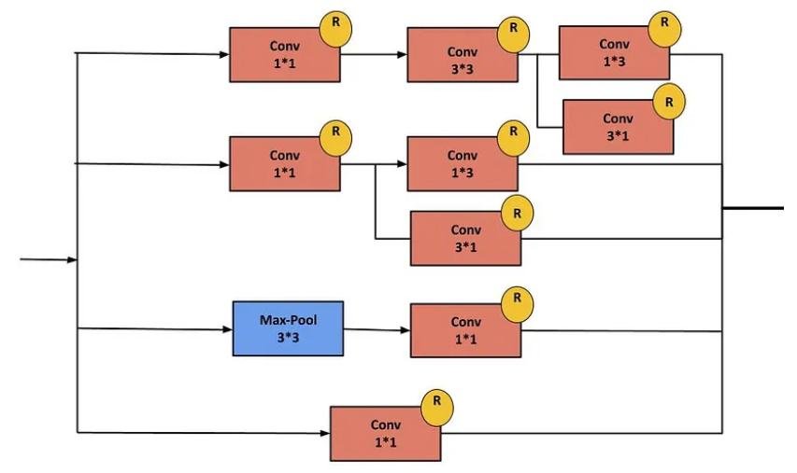
Inception-C Block

Slide 17


Model Comparison

Slide 18
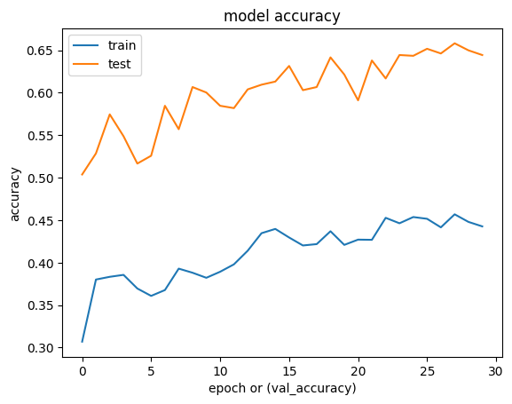
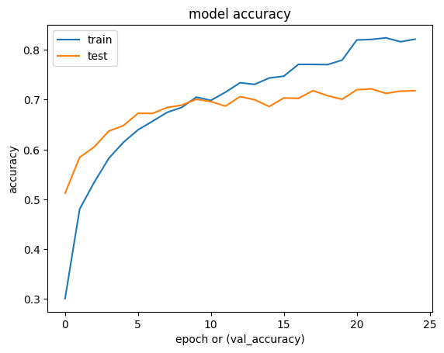
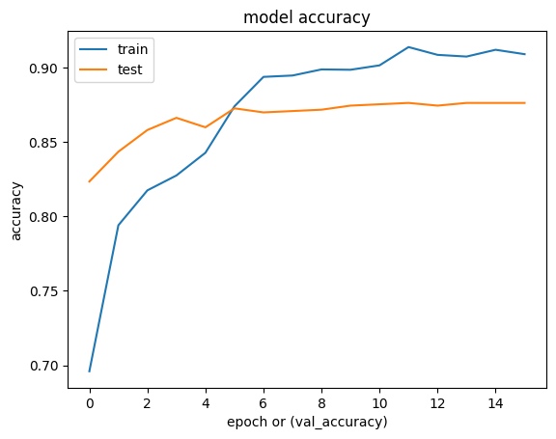
Result-Accuracy History
C.VGG16
C.VGG19
Model | Train Accuracy | Test Accuracy
VGG16 | 44.26 | 64.43
VGG19 | 82.12 | 71.79
Inception V3 | 90.90 | 87.63
Custom Inception-V3

Slide 19
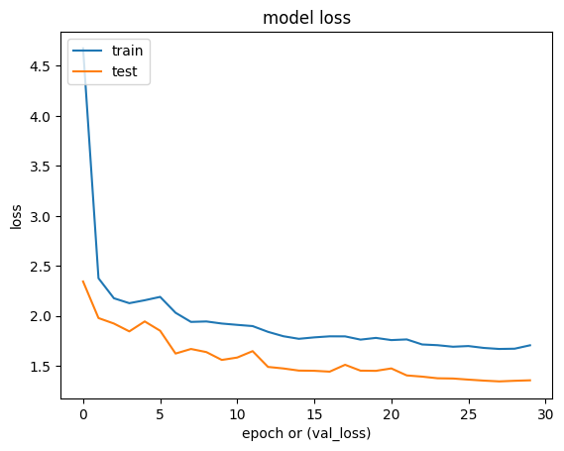
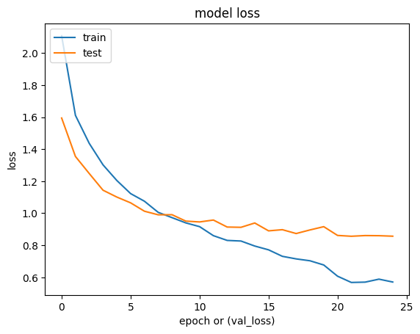
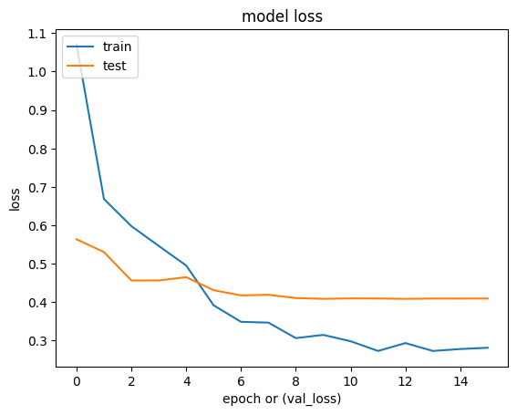
Result-Loss History
C.VGG16
C.VGG19
Customized Inception-V3

Slide 20

Thank You

